Slide 1
粒子系统及流体
韩红雷
中国传媒大学 动画学院

Slide 2
简介
PhysX 3 offers two particle system types
  generic particle system
  SPH fluid particle system
The generic particle system provides basic particle motion and collision with rigid actors. It can be used for objects that require collisions against the environment, but for which inter-particle interations are not needed. Examples include small debris, sparks or leaves
The SPH fluid particle system can be used for fluid effects that require approximate incompressibility and flowing behavior, such as liquids or fog and smoke filling up a volume.

Slide 3
PhysX 3 takes care of collision detection and particle dynamics, while auxiliary facilities such as emitters, lifetime maintenance etc. need to be provided by the application.
SampleParticles shows both particle system types being used: PxParticleSystem is used for small debris and smoke, while PxParticleFluid is used for the waterfall

Slide 4
Creating Particle Systems
Both particle system classes PxParticleSystem and PxParticleFluid inherit from PxParticleBase, which is the common interface providing particle manipulation and collision functionality. Particle systems inherit from PxActor and can be added to a scene

Slide 5
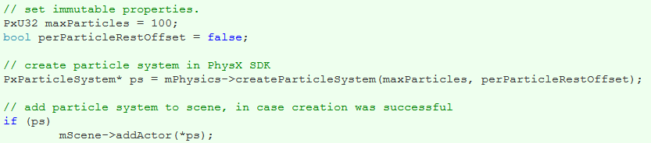

Slide 6
Properties
There are three types of particle system properties
Some need to be specified when the particle system is created and can't be changed afterwards
Some are mutable while the particle system is not part of a scene
Others can be changed at any time.

Slide 7
Immutable properties of PxParticleBase that need to be specified at creation:
maxParticles
  The maximum number of particles that can be added to a particle system. The smaller the value, the smaller the memory footprint of the particle system is going to be.
particleBaseFlags, PxParticleBaseFlag::ePER_PARTICLE_REST_OFFSET:
  Enables/disables per-particle rest offsets. Memory can be saved by turning per particle rest offsets off.

Slide 8
Properties of PxParticleBase which are immutable when the particle system is part of a scene:
maxMotionDistance:
  The maximum distance a particle can travel during one simulation step. High values may hurt performance, while low values may restrict the particle velocity too much.
gridSize:
  A hint for the PhysX SDK to choose the particle grouping granularity for proximity tests and parallelization.
restOffset:
  Defines the minimum distance between particles and the surface of rigid actors that is maintained by the collision system.
contactOffset:
  Defines the distance at which contacts between particles and rigid actors are created. The contacts are internally used to avoid jitter and sticking. It needs to be larger than restOffset.
particleReadDataFlags:
  Specifies a subset of simulation properties which are returned to the application after simulation.
particleBaseFlags, PxParticleBaseFlag::eGPU:
  Enable/disable GPU acceleration.
particleBaseFlags, PxParticleBaseFlag::eCOLLISION_TWOWAY:
  Enable/disable two-way interaction between rigid bodies and particles.

Slide 9
Properties of PxParticleFluid which are immutable when the particle system is part of a scene:
  restParticleDistance: Defines the resolution of the particle fluid.
Mutable properties of PxParticleFluid:
  stiffness: The stiffness (or gas constant) influences the calculation of the pressure force field. Low values of stiffness make the fluid more compressible (i.e., springy), while high values make it less compressible. The stiffness value has a significant impact on the numerical stability of the simulation; setting very high values will result in instability. Reasonable values are usually between 1 and 200.
  viscosity: Viscosity controls a fluid's thickness. For example, a fluid with a high viscosity will behave like treacle, while a fluid with low viscosity will be more like water. The viscosity value scales the force to reduce the relative velocity of particles within the fluid. Reasonable values are usually between 5 and 300.

Slide 10
Mutable properties of PxParticleBase:
restitution: Restitution used for particle collision.
dynamicFriction: Dynamic friction used for particle collision.
staticFriction: Static friction used for particle collision.
damping: Velocity damping constant, which is globally applied to each particle.
externalAcceleration: Acceleration applied to each particle at each time step. The scene gravity which is added to the external acceleration by default can be disabled using PxActorFlag::eDISABLE_GRAVITY.
particleBaseFlags, PxParticleBaseFlag::eENABLED: Enables/disables particle simulation.
particleBaseFlags, PxParticleBaseFlag::ePROJECT_TO_PLANE: Enables/disables projection mode which confines particles to a plane.
projectionPlaneNormal, projectionPlaneDistance: Defines plane for the projection mode.
particleMass: Mass used for two way interaction with rigid bodies.
simulationFilterData: Filter data used to filter collisions between particles and rigid bodies. See collisionFiltering.

Slide 11
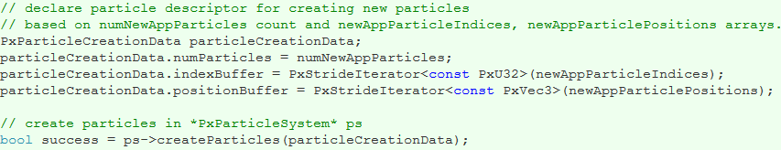
Creating Particles

Slide 12
PhysX 3 itself has no built-in emitters
it simply provides an interface to create particles with initial properties
Particles in PhysX 3 can be accessed with constant array indices throughout their lifetime
Note: In PhysX 3 all particle access such as creating, releasing, updating and reading particles can only be carried out while the simulation of the scene is not being executed.

Slide 13
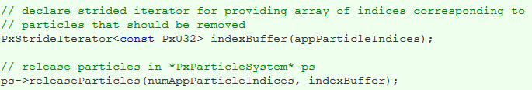
Releasing Particles
Since only a limited number of particle slots (PxParticleBase::getMaxParticles()) are available it might be appropriate to replace old particles with new ones. This can be achieved for instance by maintaining an application-side particle lifetime. There are other reasons to release particles:
  Drains can be useful to remove particles that go to locations where they are not needed anymore
  The spatial data structure used for particles may overflow. Particles that cannot be covered are marked and should be released

Slide 14
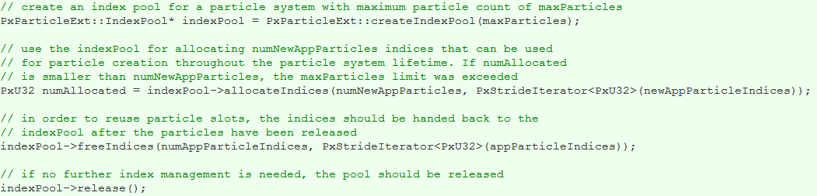
Index Pool Extension

Slide 15
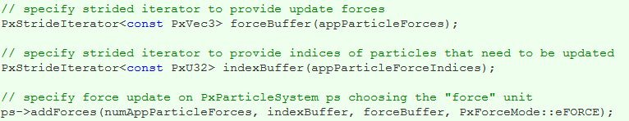
Updating Particles
The following per-particle updates are carried out immediately:
  Position updates: Teleporting particles from one location to another.
  Velocity updates: Directly altering the velocities of particles.
  Rest offset updates: Changes particle rest offsets (only available with PxParticleBaseFlag::ePER_PARTICLE_REST_OFFSET).
Particle updates that are carried out during the next scene simulation step:
  Force updates: Results in a velocity change update according to a vector unit specified by PxForceMode.
Example for force update:

Slide 16
Reading Particles
The PhysX SDK does not provide to the user all simulated per-particle properties of a particle system by default. The application can specify the data it needs by configuring PxParticleBase::particleReadDataFlags:
  PxParticleReadDataFlag::ePOSITION_BUFFER: On by default.
  PxParticleReadDataFlag::eFLAGS_BUFFER: On by default.
  PxParticleReadDataFlag::eVELOCITY_BUFFER: Off by default.
  PxParticleReadDataFlag::eREST_OFFSET_BUFFER: Off by default.
  PxParticleReadDataFlag::eCOLLISION_NORMAL_BUFFER: Off by default.
  PxParticleReadDataFlag::eDENSITY_BUFFER: Only available for particle fluids and off by default.

Slide 17
Particle flags provide more information on individual particles:
  PxParticleFlag::eVALID: If set, the particle was created beforehand and not yet released. If not set, the particle slot does not contain a valid particle. All other properties are invalid in this case and should be ignored.
  PxParticleFlag::eCOLLISION_WITH_STATIC: Shows whether a particle collided with a rigid static during the last simulation step.
  PxParticleFlag::eCOLLISION_WITH_DYNAMIC: Shows whether a particle collided with a dynamic rigid body during the last simulation step.
  PxParticleFlag::eCOLLISION_WITH_DRAIN: Shows whether a particle collided with a rigid actor shape that was marked as a drain (particleDrains).
  PxParticleFlag::eSPATIAL_DATA_STRUCTURE_OVERFLOW: Shows whether a particle had to be omitted when building the SDK internal spatial data structure (particleGrid).

Slide 18
Particle collision normals represent contact normals between particles and rigid actor surfaces. A non-colliding particle has a zero collision normal.
  Collision normals are useful e.g. for orienting the particle visualization according to their contact with rigid actors.
Particle densities provided by particle fluids can be used for rendering
  A particle density has a value of zero for a particle that is completely isolated
  It has a value of one for a particle that has a particle neighborhood with a mean spacing corresponding to PxParticleFluid::getRestParticleDistance().

Slide 19
Particle data can only be read while the scene simulation is not executing. In order to get access to the SDK buffers a PxParticleReadData instance needs to be acquired from the SDK. It has the following properties:
  numValidParticles: Total number of valid particles for the corresponding particle system.
  validParticleRange: The index range of valid particles in the particle buffers.
  validParticleBitmap: Bitmap of valid particle locations.
  positionBuffer, positionBuffer, velocityBuffer, restOffsetBuffer, flagsBuffer, collisionNormalBuffer: Strided iterators for particle properties.
Additionally paticle fluids provide PxParticleFluidReadData with
  densityBuffer: Strided iterator for particle densities.

Slide 20
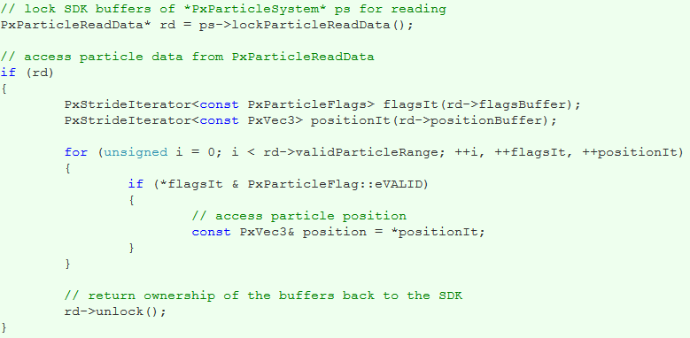
Example of how to access particle data

Slide 21
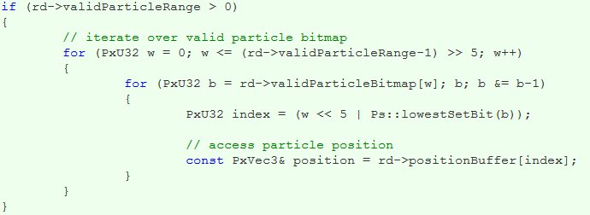
Example of how to use the valid particle bitmap to access particle data

Slide 22
Particle Drains
The drain represents a lake that the fluid particles flow into, and is used as a general safety net in case any particles escape from the level.
Drains are generally a good method for keeping the particle count and spread under control. Placing drains around the area of interest in which a particle system is used helps to maintain good performance of the particle simulation. The area of interest could, for example, also be moved with the player.

Slide 23
Example of how to flag a PxShape rbShape as a drain:
Particles that collide with a drain are marked with PxParticleFlag::eCOLLISION_WITH_DRAIN and may be released.

Slide 24
Particle Grid and Spatial Data Structure Overflow
The PhysX SDK uses a grid to subdivide the particles of a particle system into spatial groups. This is done to accelerate proximity queries and for parallelization purposes. The grid size parameter needs to be experimentally adjusted with PxParticleBase::setGridSize() for best performance. When doing this it is helpful to visualize the grid using PxVisualizationParameter::ePARTICLE_SYSTEM_GRID.
Small grid size values might result in spatial data structure overflow, since the number of grid cells is limited to about 1000. Large grid size values on the other hand might result in poor performance due to ineffective spatial queries or lack of parallelization opportunities.
In case of overflow, some particles will stop colliding with rigid actors in the scene. These particles are marked with PxParticleFlag::eSPATIAL_DATA_STRUCTURE_OVERFLOW and should be released.

Slide 25
Collision Filtering
Filtering particle versus rigid body collisions can be useful to avoid unnecessary performance overhead or simply to avoid undesired collisions
Filter information for particles can be specified by calling PxParticleBase::setSimulationFilterData().

Slide 26
Additional SampleParticles Information
The sample makes use of various helper classes:
  ParticleSystem: Encapsulates a PxParticleSystem or PxParticleFluid instance and manages application side data such as particle lifetimes and orientations for debris. It facilitates creating and releasing particles and double buffers particle data for asynchronous rendering.
  RenderParticleSystemActor: Owns a ParticleSystem and provides rendering functionality.
  ParticleEmitterRate: Emits particles at a specified rate (#particles per second).
  ParticleEmitterPressure: Emits particles maintaining a certain distance between them.
  SampleParticles::Emitter: Connects an emitter as described above with a RenderParticleSystemActor.
  SampleParticles::Raygun: Provides functionality for the ray force field, rigid body debris, particle debris and smoke emission.

Slide 27
In the sample, the smoke effect is achieved by using a PxParticleSystem without gravity. Each particle is rendered as a point sprite with a smoke texture. The sprites fade away when the particles get close to the end of their lifespan. The smoke particles collide with the scene, which can be seen when roaming the smoke with the ray-gun. Smoke is generated for the craters, as well as for the ray-gun impacts.
Two kinds of debris are shown in the sample. Larger chunks of debris are represented using convex-shaped rigid bodies. Smaller but more abundant chunks are represented by particles, which helps performance. The particle based debris is rendered using instanced meshes. It is spawned in the craters and at the ray-gun impact location.
In order to give the chunks the appearance of a tumbling motion a simple trick is used.
  Assign an initial random rotation matrix to each particle.
  Change this rotation matrix proportional to the linear velocity of particle.

Slide 28
流体概念
Fluids用来模拟液体和气体
使用粒子系统来完成模拟
有两种方式来从场景中移除流体粒子
  使用drain
  使用粒子的lifetime

Slide 29
流体属性
maxParticles – 用来模拟流体的粒子最大数目
restParticlesPerMeter – 在休眠条件下,每米的粒子数目
restDensity – 流体的目标密度（水大概是1000）
kernelRadiusMultiplier – 粒子交互的影响半径
packetSizeMultiplier –流体的parallelization
stiffness –粒子间交互的刚性
viscosity – 流体的粘性
damping – 粒子运动的阻尼
externalAcceleration – 粒子的加速度
simulationMethod –是否考虑粒子的交互

Slide 30
粒子属性
Position – 粒子的位置
Velocity – 粒子的线性速度
Density – 特定粒子周围的流体密度
Life – 粒子的生存时间（以秒计量）

Slide 31
流体粒子间的交互
有两种流体模拟的方式：
  SPH (Smoothed Particle Hydrodynamics)
    考虑粒子间的交互
  Not SPH
    不考虑粒子间的交互
Notes:
Fluid simulation can occur in two modes, one called SPH (Smoothed Particle Hydrodynamics) where interparticle forces are considered (e.g. viscous drag) and another simple mode where these forces are not considered. SPH is important when simulating dense collections of particles (e.g., liquids) but is not the best for performance; therefore, simple mode should be used when interparticle forces are not a consideration (e.g., a very thin gas).
Particle interaction is simulated in SPH using a number of force fields associated with each particle. The pressure force field has the effect of pushing particles apart and the viscosity forces have the effect of reducing the relative velocity between particles.
Surface tension is modeled through an attractive force between particles. Inside the fluid, the surface tension forces balance each other out. However, at the surface of the fluid they act in the opposite direction of the surface normal which tends to reduce the curvature of the fluid's surface.
When simulating a fluid, the mass of each particle remains constant; however, the density varies over time due to the fluid's compressibility. The change in density is therefore achieved through the movement of particles. An area of the fluid with high density is caused by a closely packed clump of particles.

Slide 32
流体构造
有两种构造流体的方式：
  使用NxScene::createFluid() 直接构造
  使用NxFluid::createEmitter() 构造发射器
前者直接使用fluid描述符构造流体
后者使用发射器，可以连续构造流体

Slide 33
发射器构造流体的属性
relPose –发射器在所属shape中的位置
type –发射器的类型 NX_FE_CONSTANT_PRESSURE、(NX_FE_CONSTANT_FLOW_RATE
shape – 发射器的形状 (NX_FE_RECTANGULAR) or (NX_FE_ELLIPSE)
particleLifetime – 粒子的生存期，如果是0的话，将一直存在到其碰到drain
maxParticles – 构造的最大粒子数，如果是0的话将一直构造
fluidVelocityMagnitude – 发射器构造的流体粒子的速度级别
rate – 发射器的发射速度只在 NX_FE_CONSTANT_FLOW_RATE时有效
dimensionX, dimensionY – 发射器的尺寸（relPose中的前两维）
randomAngle –发射器发射方向的范围 （ relPose的第三维）
randomPos –发射粒子的随机位置范围

Slide 34
排水渠（Fluid Drains）
是一种标志位NX_SF_FLUID_DRAIN的shape
当粒子遇到排水渠shape的时候将移除
支持的shape类型：
  Box - NxBoxShape
  Sphere - NxSphereShape
  Capsule - NxCapsuleShape
  Convex - NxConvexShape (Only dynamic shapes)
  Plane - NxPlaneShape
Notes:
Fluid drains are not objects in there own right; rather, they are shapes with the NX_SF_FLUID_DRAIN flag set applied to the NxShapeDesc::shapeFlags member, causing particles colliding with them to be removed from the simulation. Below is a list of currently supported static and dynamic drain shapes:
Box - NxBoxShape
Sphere - NxSphereShape
Capsule - NxCapsuleShape
Convex - NxConvexShape (Only dynamic shapes)
Plane - NxPlaneShape
Drains are an important method in keeping the particle count and spread under control. Place drains around the area in which a fluid is used to stop the fluid particles from spreading too far and negatively impacting performance.

Slide 35
流体事件
两种可以监听的流体事件
  当发射器为空的时候
  当流体为空的时候
构造方式和之前学习的内容类似
Notes:
In version 2.7.0 we added two events for the user to listen to, for making it easier to use the Fluid functionality. The events are raised when an emitter is empty and when a fluid is empty. The event callback class is called NxFluidUserNotify and controlled through the following interface: void NxScene::setFluidUserNotify(NxFluidUserNotify* callback) NxFluidUserNotify* NxScene::getFluidUserNotify() const NxFluidUserNotify* NxSceneDesc::fluidUserNotify The callback interface is described in the API documentation, but currently consists of the following two functions:
//The user needs to return whether he wants to delete the emitter, in the callback. bool NxFluidUserNotify::onEmitterEvent(NxFluidEmitter& emitter, NxFluidEmitterEventType eventType) //The user needs to return whether he wants to delete the fluid, in the callback. bool NxFluidUserNotify::onEvent(NxFluid& fluid, NxFluidEventType eventType) Also see the SampleEvents part of the SampleParticleFluid code for a use case.

Slide 36
渲染流体
可以有一些缓存区存储粒子的信息
  bufferPos - position of each individual particle.
  bufferVel - velocity of each particle.
  bufferLife - lifetime of each particle.
  bufferDensity - density for each particle.
  bufferId - SDK-generated unique particle ID.
  bufferFlag - NxParticleFlag values for each particle.
在渲染的时候读取这些信息

Slide 37
流体和其他物体的交互
使用 NxFluidDesc::collisionMethod 增加标志NX_F_STATIC 、 NX_F_DYNAMIC
NxFluidDesc::restitutionForDynamicShapes NxFluidDesc::restitutionForStaticShapes
  碰到动态物体、静态物体的时候的弹起高度
NxFluidDesc::dynamicFrictionForDynamicShapes NxFluidDesc::dynamicFrictionForStaticShapes NxFluidDesc::attractionForDynamicShapes NxFluidDesc::attractionForStaticShapes
  流体和其他物体之间的摩擦力

Slide 38
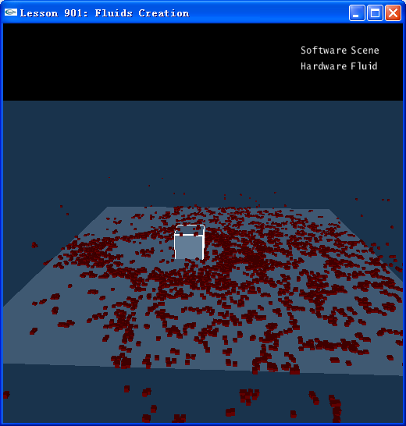
流体构造

Slide 39
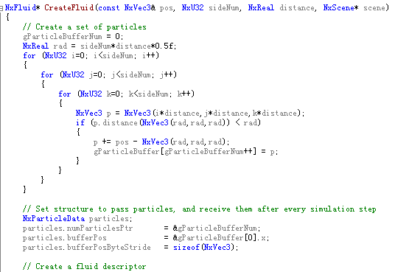
代码分析

Slide 40
随堂作业（30分钟）
掌握使用粒子构造流体的方法
流体的属性如何影响流体的行为
如何渲染流体

Slide 41
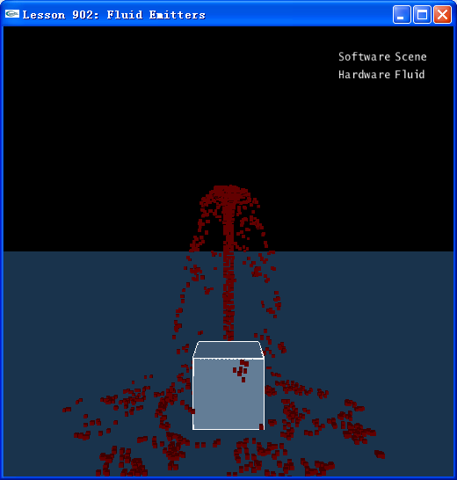
流体发射器

Slide 42
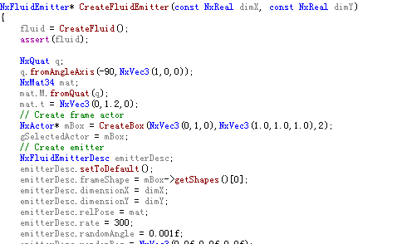
代码分析

Slide 43
随堂作业（20分钟）
如何使用粒子系统模拟类似武器的效果
如何模拟更为复杂的流体效果
  烟雾等

Slide 44
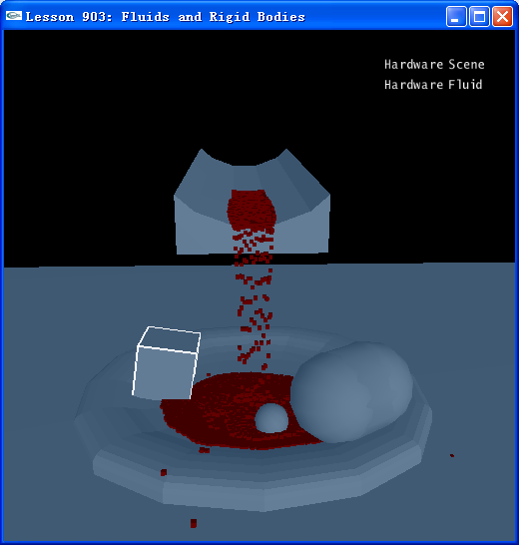
流体和其他物体的交互

Slide 45
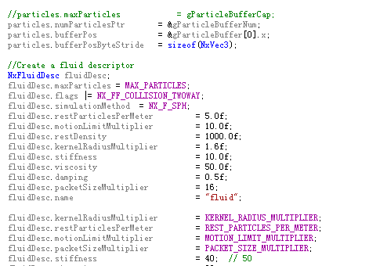
代码分析

Slide 46
随堂作业（30分钟）
尝试粒子和布料进行交互
那些属性会影响到交互的表现

Slide 47
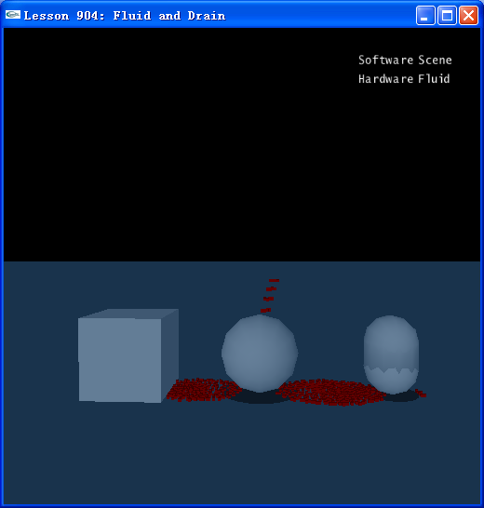
流体的消亡

Slide 48
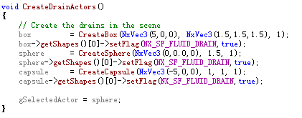
代码分析

Slide 49
随堂作业（20分钟）
流体消亡的原理
构造更加有意义的效果

Slide 50
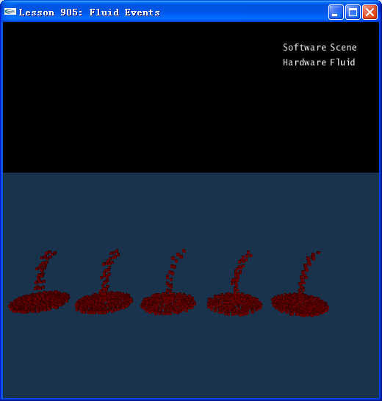
流体事件

Slide 51
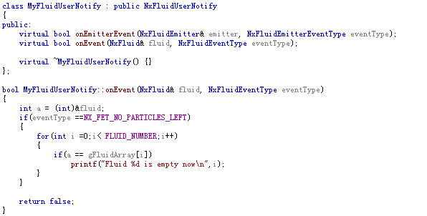
代码分析

Slide 52
随堂作业（20分钟）
了解流体事件的原理及使用
做出更有意义的效果

Slide 53
总结
流体使用粒子系统来模拟
定义流体的不同属性可以模拟不同材质的液体或者气体
利用流体的其他特性可以和游戏中的其他物体更好交互

